Slide 1
Dimensionality Reduction
A presentation for Training at RRCAT, Indore
-By Brijgopal Bharadwaj

Slide 2
What are Dimensions?
No. of variables considered for the formation of the model.
The set of measures against which the output is compared to find patterns and relationships between and among them.
Inputs for the modelling process.

Slide 3
Curse of Dimensionality:
Low no. of dimensions and high no. of dimensions both present unique challenges for the data scientist working with them, as follows:
CASE-1: LOW DIMENSIONALITY:
Low no. of dimensions may fail to successfully record and represent the relationships present in real-world.
It may even lead to incorrect analysis of data, and thus incorrect interpretations.
The model thus obtained may not be the most optimized solution possible.

Slide 4
CASE-2: HIGH DIMENSIONALITY:
As the number of features increase, the number of samples also increases proportionally. The more features we have, the more number of samples we will need to have all combinations of feature values well represented in our sample.
More dimensions make the data harder to comprehend and visualize.
It often leads to overfitting of the data.
It makes understanding and communicating the relationships between various attributes much more challenging than it needs to be.

Slide 5
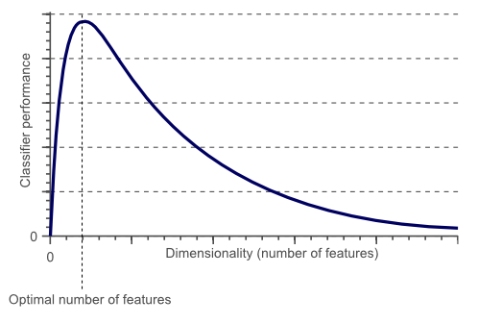
Hughes Phenomenon:
Hughes Phenomenon shows that as the number of features increases, the classifier’s performance increases as well until we reach the optimal number of features. Adding more features based on the same size as the training set will then degrade the classifier’s performance.

Slide 6
Dimensionality Reduction
It refers to the process of reduction of the number of random variables/attributes under consideration, in such a manner that the remaining attributes account for the most significant data patterns and relationships, from a statistical point of view.
It is basically a compromise between the accuracy and ease of computation, to obtain the most optimized version of the model.
The objective is to hold on to maximum possible data, along with its inherent characteristics, while getting rid of the unnecessary attributes with little or no contribution to the model-accuracy, via a logical, systematic, and understandable approach.

Slide 7
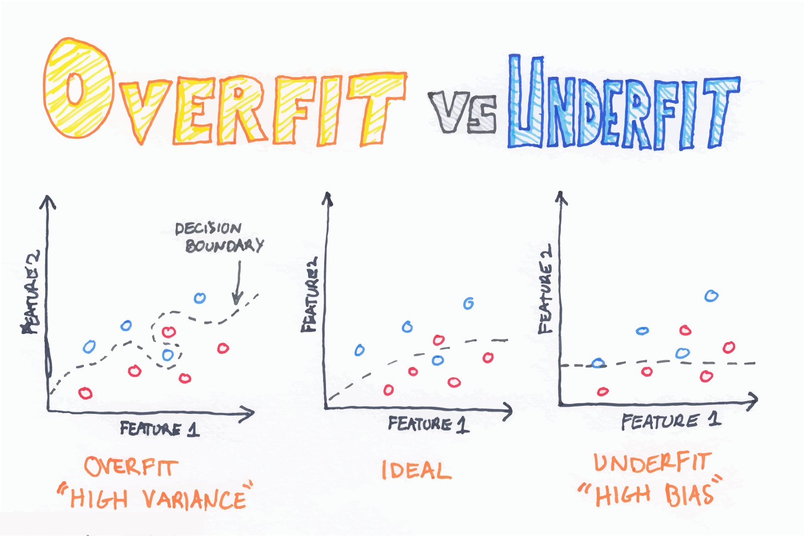

Slide 8
Dimensionality Reduction types:
Feature Selection:
Filter methods
Wrapper methods
Feature Extraction:
Principle Component Analysis (PCA)
Linear Discriminant Analysis (LDA)

Slide 9
Feature Selection:
also known as variable selection, attribute selection or subset selection.
It is the automatic selection of attributes in the data (such as columns in tabular data) that are most relevant to the predictive modelling problem under consideration.
It can be further classified in the following categories:
Wrapper methods
Filter methods

Slide 10
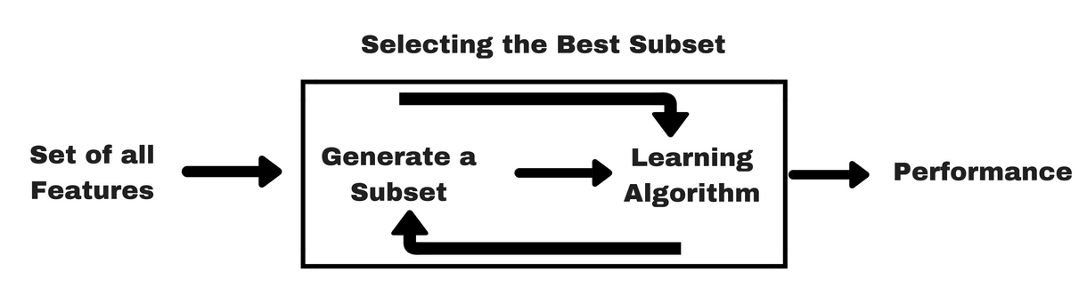
Wrapper methods:
Wrapper methods consider the selection of a set of features as a search problem, where different combinations are prepared, evaluated and compared to other combinations. A predictive model us used to evaluate a combination of features and assign a score based on model accuracy.
The search process may be methodical such as a best-first search, it may stochastic such as a random hill-climbing algorithm, or it may use heuristics, like forward and backward passes to add and remove features.

Slide 11
Backward Elimination:
Typically, it can be performed in just 5 simple steps:
Select a significance level, say 5% (0.05)
Fit a model with all features (variables)
Consider the feature with the highest P-Value. If its P-value is greater than significance level (P > SL), go to step 4. Else, your model is ready.
Eliminate this feature (variable).
Fit a model with the new set of features, and go to step 3.

Slide 12
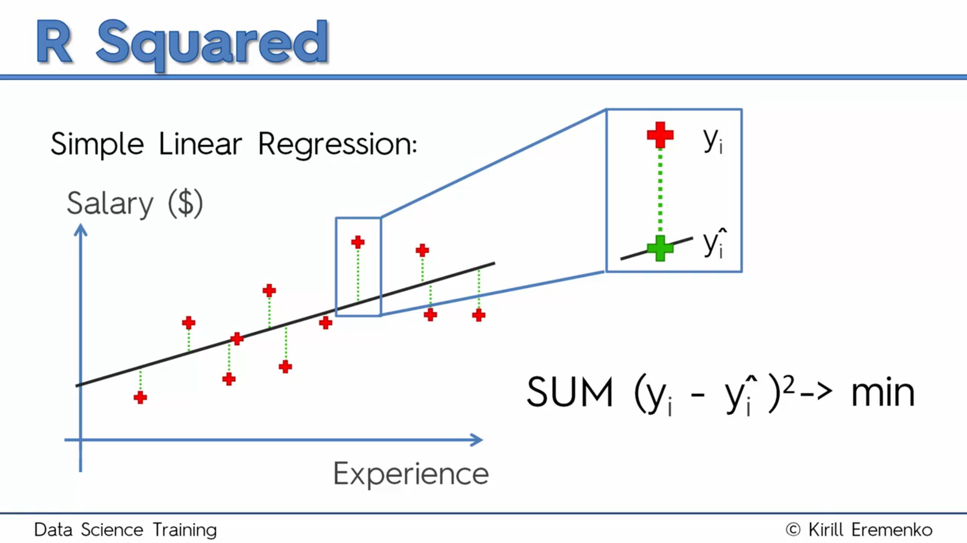

Slide 13
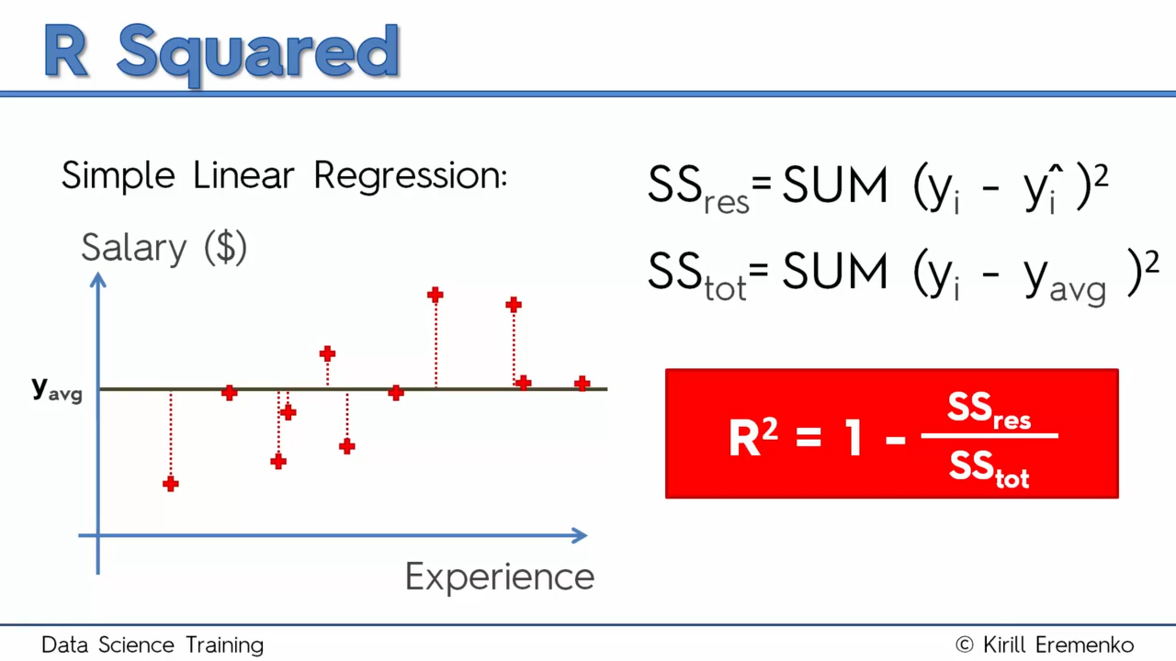

Slide 14
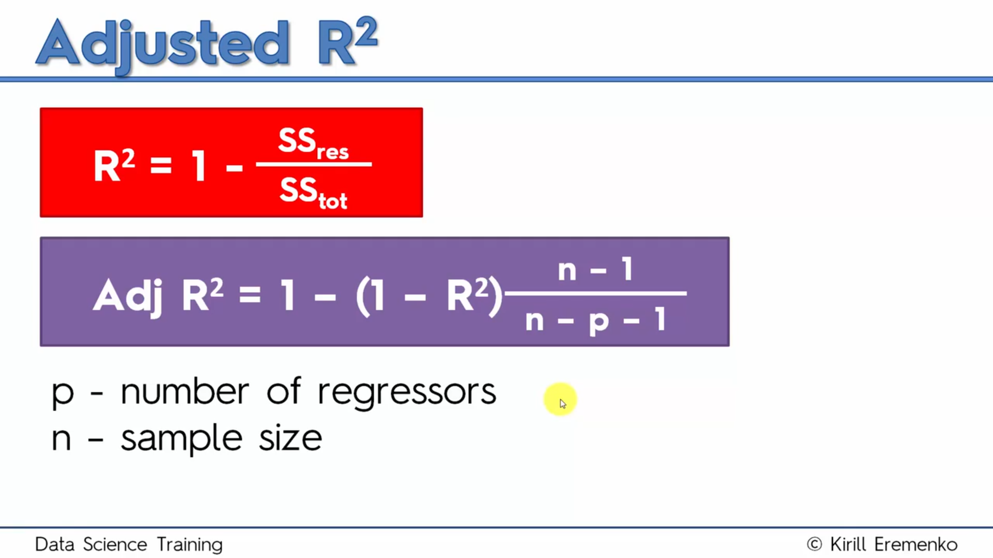

Slide 15
Forward Selection:
Typically, it can be performed in just 4 simple steps:
Select a significance level, say 5% (0.05)
Fit all simple models, and out of all these, select the one with the least p-value
With these variables, fit all possible models with one extra predictor.
Add the predictor with the lowest p-value to the list of accepted predictors, and then move back to step-3 if the p<SL, otherwise end.

Slide 16
Filter methods:
Filter feature selection methods apply a statistical measure to assign a scoring to each feature. The features are ranked by the score and either selected to be kept or removed from the dataset. The methods are often univariate and consider the feature independently, or with regard to the dependent variable.
Some examples of some filter methods include the Chi squared test, information gain and correlation coefficient scores.

Slide 17
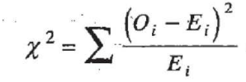
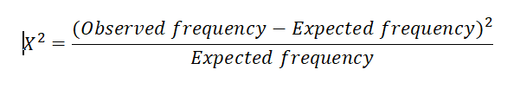
Chi-Squared method:
Chi-square test is used for categorical features in a dataset. We calculate Chi-square between each feature and the target and select the desired number of features with best Chi-square scores. It determines if the association between two categorical variables of the sample would reflect their real association in the population.
Where:
Observed frequency = No. of observations of class
Expected frequency = No. of expected observations of class if there was no relationship between the feature and the target.

Slide 18
The chi-square test is a statistical test of independence to determine the dependency of two variables. It shares similarities with coefficient of determination, R². However, chi-square test is only applicable to categorical or nominal data while R² is only applicable to numeric data.
From the definition of chi-square, we can easily deduce the application of chi-square technique in feature selection. Suppose you have a target variable (i.e., the class label) and some other features (feature variables) that describes each sample of the data. Now, we calculate chi-square statistics between every feature variable and the target variable and observe the existence of a relationship between the variables and the target. If the target variable is independent of the feature variable, we can discard that feature variable. If they are dependent, the feature variable is very important.

Slide 19
Feature Extraction:
Also called feature projection.
Feature extraction is the transformation of original data to a data set with a reduced number of variables, which contains the most discriminatory information.
Some of the most popular algorithms of this category are:
Principle Component Analysis (PCA)
Linear Discriminant Analysis (LDA)

Slide 20
Principal Component Analysis (PCA):
Principal Component Analysis, or PCA, is a dimensionality-reduction method that is often used to reduce the dimensionality of large data sets, by transforming a large set of variables into a smaller one that still contains most of the information in the large set.
Reducing the number of variables of a data set naturally comes at the expense of accuracy, but the trick in dimensionality reduction is to trade a little accuracy for simplicity. Because smaller data sets are easier to explore and visualize and make analyzing data much easier and faster for machine learning algorithms without extraneous variables to process.

Slide 21
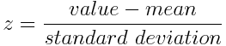
Step 1: Standardization / Normalization:
the reason why it is critical to perform standardization prior to PCA, is that the latter is quite sensitive regarding the variances of the initial variables. That is, if there are large differences between the ranges of initial variables, those variables with larger ranges will dominate over those with small ranges (For example, a variable that ranges between 0 and 100 will dominate over a variable that ranges between 0 and 1), which will lead to biased results. So, transforming the data to comparable scales can prevent this problem.
Normalized value:
Once the standardization is done, all the variables will be transformed to the same scale.

Slide 22
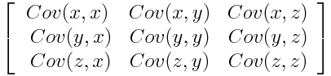
Step 2: Covariance Matrix computation:
to understand how the variables of the input data set are varying from the mean with respect to each other, or in other words, to see if there is any relationship between them.
sometimes, variables are highly correlated in such a way that they contain redundant information, and are bad for the model formation.
The covariance matrix is a p × p symmetric matrix (where p is the number of dimensions) that has as entries the covariances associated with all possible pairs of the initial variables.

Slide 23
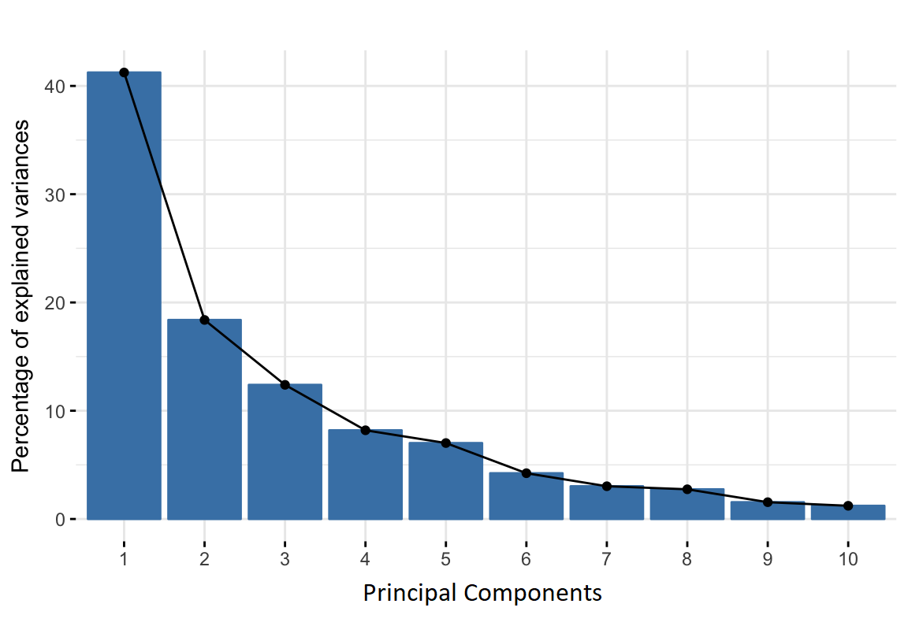
Step 3: Compute the Eigenvectors & Eigenvalues:
Principal components are new variables that are constructed as linear combinations or mixtures of the initial variables. These combinations are done in such a way that the new variables (i.e., principal components) are uncorrelated and most of the information within the initial variables is squeezed or compressed into the first components.

Slide 24

Geometrically speaking, principal components represent the directions of the data that explain a maximal amount of variance, that is to say, the lines that capture most information of the data.
To put all this simply, just think of principal components as new axes that provide the best angle to see and evaluate the data, so that the differences between the observations are better visible.
http://setosa.io/ev/principal-component-analysis/

Slide 25
eigenvectors of the Covariance matrix are actually the directions of the axes where there is the most variance (most information) and that we call Principal Components. And eigenvalues are simply the coefficients attached to eigenvectors, which give the amount of variance carried in each Principal Component.
By ranking your eigenvectors in order of their eigenvalues, highest to lowest, you get the principal components in order of significance.
If we find the ratio between each eigenvector & their sum, we get the ratio of the data/variance represented by each corresponding eigenvector. Thus, we can take as many Eigenvectors/Principle components as we need, to reach the desired level of accuracy.

Slide 26
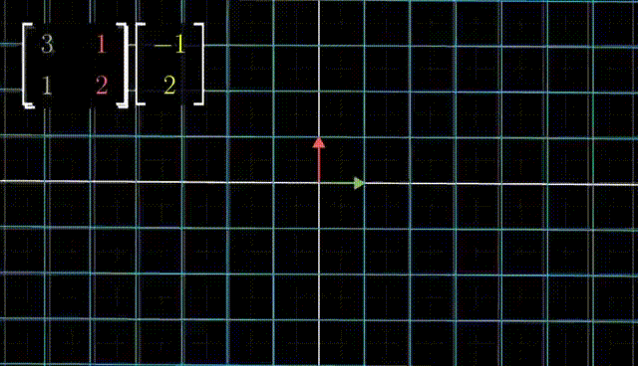

Slide 27
Step 4: Feature vector:
In this step, we choose whether to keep all these components or discard those of lesser significance (of low eigenvalues), and form with the remaining ones a matrix of vectors that we call Feature vector.
So, the feature vector is simply a matrix that has as columns the eigenvectors of the components that we decide to keep. This makes it the first step towards dimensionality reduction, because if we choose to keep only p eigenvectors (components) out of n, the final data set will have only p dimensions.

Slide 28
Step 5: Recast data along the principal components axes:
use the feature vector formed using the eigenvectors of the covariance matrix, to reorient the data from the original axes to the ones represented by the principal components (hence the name Principal Components Analysis). This can be done by multiplying the transpose of the original data set by the transpose of the feature vector.

Slide 29
Thank You !!!!

